Slide 1
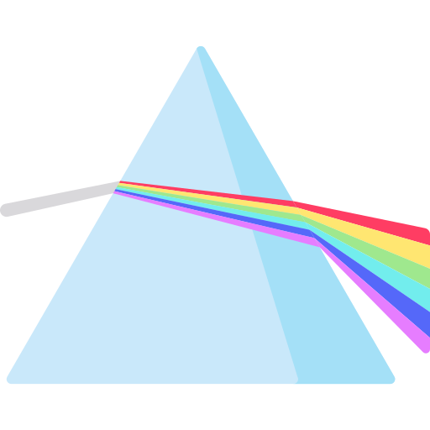
Light and Shadow
KNOWLEDGE ORGANISER
ESSENTIAL LIGHT AND SHADOW VOCABULARY
light | A form of energy that travels from its source in a wave.
light source | An object that creates light.
reflect | When light bounces off a surface and changes the direction of a ray of light
refract | To make a ray of light change direction when it hits at an angle.
prism | A solid 3D shape. A transparent prism separates visible light into the spectrum of colours
ray | A wave of light.
shadow | An area of darkness where light is blocked.
reflective | A material which reflects light well.
pupil | The black part of the eye which lets light in.
retina | The layer at the back of the eye that takes in light and sends nerve signals to the brain.
spectrum | A band of colours made by separating the components of light.
pioneer | Someone who is among the first to explore somewhere or apply something.
opaque | Objects that do not allow any light to travel through them,
transparent | Objects that allow light to easily travel through them,
translucent | Objects that allow some light to travel through, but it is scattered.
Parts of the Eye
The pupil controls the amount of light that enters the eye, in order to protect the retina. It is an opening at the front of the eye that dilates (gets bigger) when it’s dark and constricts (gets smaller) when it is bright.
Facts about Light
It travels faster than sound. Darkness is caused by the absence of light. It travels in a straight line. The moon is not a light source as it reflects light from the Sun. Light can travel through the airless vacuum of space.
Refraction
Objects in water (like a pencil in a glass of water) can appear as if they are bent. This is because when light moves from air to water, it bends. The light beam reflected from the underwater pencil part come out of the water in a different direction.
pupil
retina
The Law of Reflection
The angle of incidence is always equal to the angle of reflection. The angle of incidence is between the incident ray and the normal line. The angle of reflection is between the reflected ray and the normal line.
Colour
When white light passes through a clear glass prism. This means that it changes direction and is spread out as it exits the prism. Often, a spectrum of colours can be seen. Isaac Newton was a pioneer who discovered that the colours merge together to make visible light.
angle of incidence
normal line
angle of reflection
incident ray
reflected ray
Shadows
Shadows are always the same shape as the object that has cast them because they are formed when an opaque object blocks the light travelling from the light source. They can be stretched or shortened depending on the angle of the light source. A shadow is larger when the object is closer to the light source as more of the light is blocked.
MAKING LINKS TO PREVIOUS LEARNING GOLDEN VOCABULARY
Explorers | Neil Armstrong was a pioneer as the first man to step onto the moon.
Materials | Wood is an example of an opaque material.
Materials | Glass is an example of a transparent material.
Materials | Frosted glass is an example of a translucent material.
© Vocabulary Ninja Ltd 2021

